Slide 1


Model Context Protocol
A Dasmlab tour

Slide 2
What is MCP about
Open Protocol that standardizes how applications provide “CONTEXT” to LLMs.
The MCP provides a standardized way to connect AI models to different data sources and tools.

Slide 3
What does MCP provide?
Pre-Built Integrations your LLM can directly plug into
Flexibility to switch between LLM providers and vendors
Best Practice implementations for securing data within an organization's infrastructure.

Slide 4
General Architecture
MCP follows basic Client-Server Architecture, with a 1:1 relationship between MCP Client and MCP Servers over the MCP Protocol
Data Boundary
MCP Protocol
MCP Server A
Data Source A
Data Boundary
MCP Client (Claude, IDE, AI Toos)
MCP Server B
Data Source B
MCP Protocol
MCP Server C
Remote/Internet Service
MCP Protocol

Slide 5
MCP Key Elements
MCP Hosts:
Programs like Claude Desktop, IDEs, or AI tools that want to access data through MCP
MCP Clients:
Protocol clients that maintain 1:1 connections with servers
MCP Servers:
Lightweight programs that each expose specific capabilities through the standardized Model Context Protocol
Local Data Sources:
Your computer’s files, databases, and services that MCP servers can securely access
Remote Services:
External systems available over the internet (e.g., through APIs) that MCP servers can connect to
Prompts, Tools and Resources
These are the Main FeatureSets that a MCP Server provides Types for handling within MCP

Slide 6
Lets Build it - with GO!
So, we will build out a simple MCP Client and MCP server implementing the MCP protocol using the experimental Golang library that Google and Anthropic are developing.
We will wrap it in a container and then a K8s Manifest for our Deployment Envelope overall.
Things we want to Achieve in this layout
Test drive the MCP G0-SDK that is in development and learn the MCP protocol in the process
Build a simple GO Client/Server boilerplate that we can examine some of the MCP Roadmap items with later (Discovery via MCP Registry, Agent Graphs and Interactive Workflows)

Slide 7
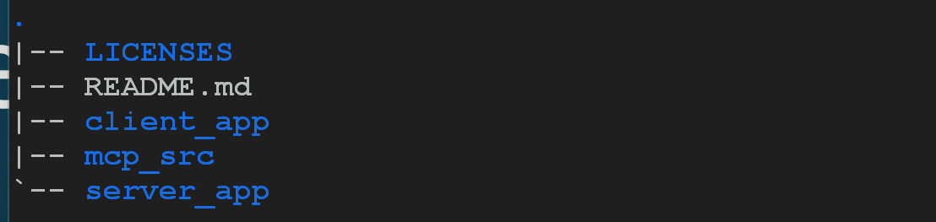
Tour Development Setup
The Code can be found here: https://github.com/lmcdasm/mcp-tour
System Requirements:
- I did this with a VM Running Ubuntu with a Decent amount of CPU, RAM, Docker and internet Access
- you should install golang (either with snap, apt-get or from source) – https://golang.org
Basic Project Layout:
- In general, you will play in either client_app or server_app directories.
- The Client and Server both run as independent go-projects under the mcp-tour git repo.
client_app – A working MCP-GO Client Boilerplate
server_app – A working MCP-GO Server Boilerplate
mcp_src – A copy of https://googlesource/tools/internal/mcp

Slide 8
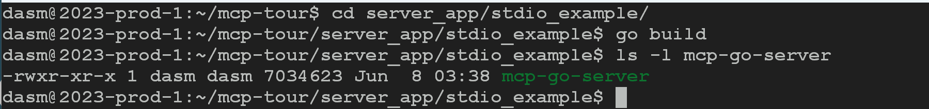
Simple Client/Server Demo (TL;DR)
To get running quickly, you can do the following steps to run the STDIO transport between a Client and Server
Step 1 – Clone the REPO Step 4 – Run “./mcp-go-client” from the directory its built and see the result
Step 2 – Change to the server_app/stdio_example directory and build (go build). This will create “mcp-go-server” binary
Step 3 – Change to the client_app/stdio_example directory and build (go build). This will create the “mcp-go-client” binary
Step 4 – Run “./mcp-go-client” from the directory its built and see the result

Slide 9
MCP GoSDK Resources
The SDK is currently under development by Google and Anthropic - all credits to both teams! and not released yet (go get wont work!)
Active Discussion Link:
https://github.com/orgs/modelcontextprotocol/discussions/364
GO SDK internal development Link:
https://go.googlesource.com/tools/+/refs/heads/master/internal/mcp/
Main MCP Page:
https://modelcontextprotocol.io/introduction
MCP Roadmap Page:
https://modelcontextprotocol.io/development/roadmap
MCP Github Main Page (Code):
https://github.com/modelcontextprotocol

Slide 10
MCP Key Primitives
Resources are a core primitive in the Model Context Protocol (MCP) that allow servers to expose data and content that can be read by clients and used as context for LLM interactions.
Resources are designed to be Application-Controlled
Resources
Prompts enable servers to define reusable prompt templates and workflows that clients can easily surface to users and LLMs. They provide a powerful way to standardize and share common LLM interactions.
Prompts are designed to be User-controlled
Prompts
Tools are a powerful primitive in the Model Context Protocol (MCP) that enable servers to expose executable functionality to clients. Through tools, LLMs can interact with external systems, perform computations, and take actions in the real world.
Tools are designed to be Model-controlled
Tools

Slide 11
MCP Key Primitive - Resources
Resources represent any kind of data that a MCP Server wants to make available to clients.
This includes:
File content, Database Records, API Responses
Live System Data, Screenshots and Images
Log Files, Metrics and other Telemetry information
Resources are Defined by a URI:
[protocol]://[host]/[path]
Examples:
file:///home/user/documents/report.pdf
postgres://database/customers/schema
screen://localhost/display1
The protocol and path structure is defined by the MCP server implementation. Servers can define their own custom URI schemes.

Slide 12
MCP Key Primitive - Resources
Resources can have 2 Types of Content
Text Resources
Source Code, Configuration Files, Log Files, JSON/XML data, Plain Text
Binary Resources
Images, PDFs, Audio Files, Video Files, Other non-Text Formats (Custom)

Slide 13
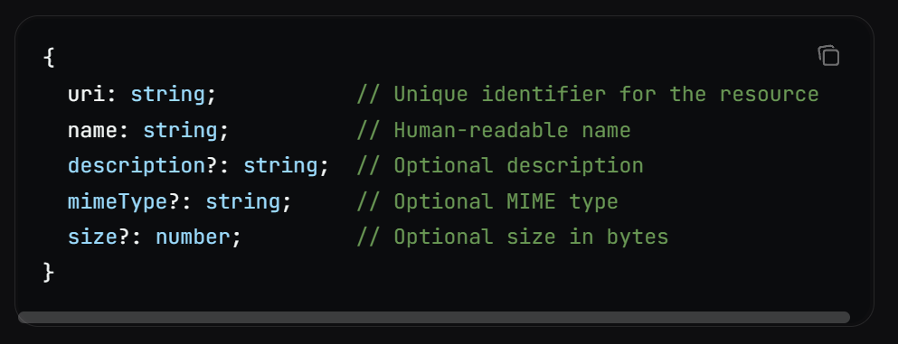
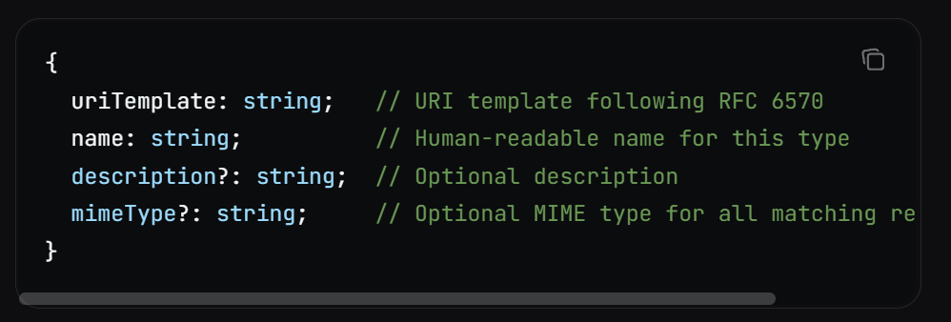
MCP Key Primitive - Resources
Resources Discovery has two main methods
Direct Resources (static)
Servers Expose a list of concrete resources via resources/list endpoint
Example Direct Resource Definition:
Resource Templates (dynamic)
Servers Expose URI Templates (RFC 6570) that clients can build valid Resource URIs with
Example Resource Template Definition:

Slide 14
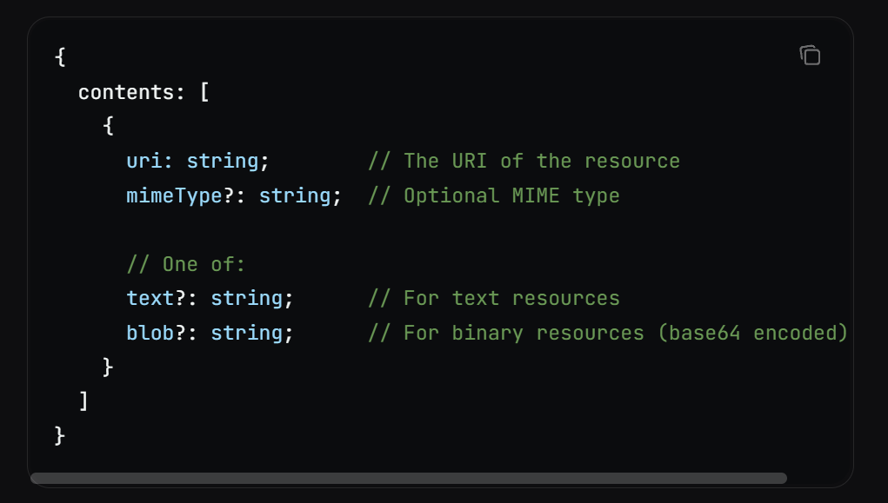
MCP Key Primitives - Resources
To read a Resource, Clients make a call to “resources/read” endpoint on a MCP Server with the Resource Specific URI.
A Resource Response from a Server looks as shown:

Slide 15
MCP Key Primitive - Prompts
Prompts enable servers to define reusable prompt templates and workflows that clients can easily surface to users and LLMs. They provide a powerful way to standardize and share common LLM interactions.
Prompts in MCP are predefined templates that can:
Accept dynamic arguments
Include context from resources
Chain multiple interactions
Guide specific workflows
Surface as UI elements (like slash commands)

Slide 16
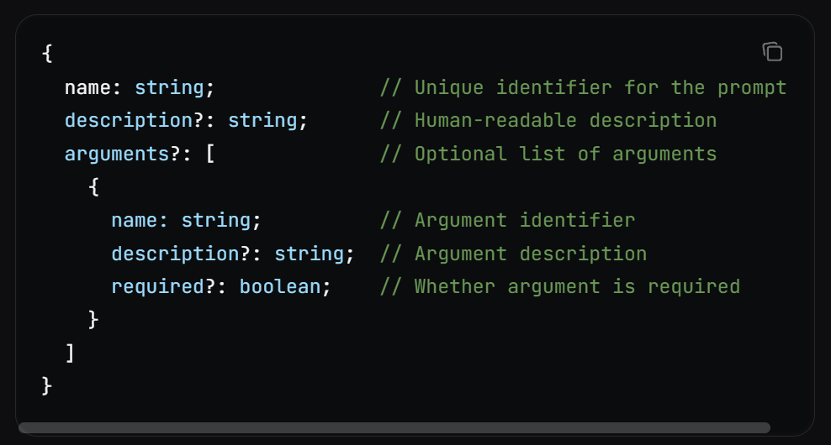
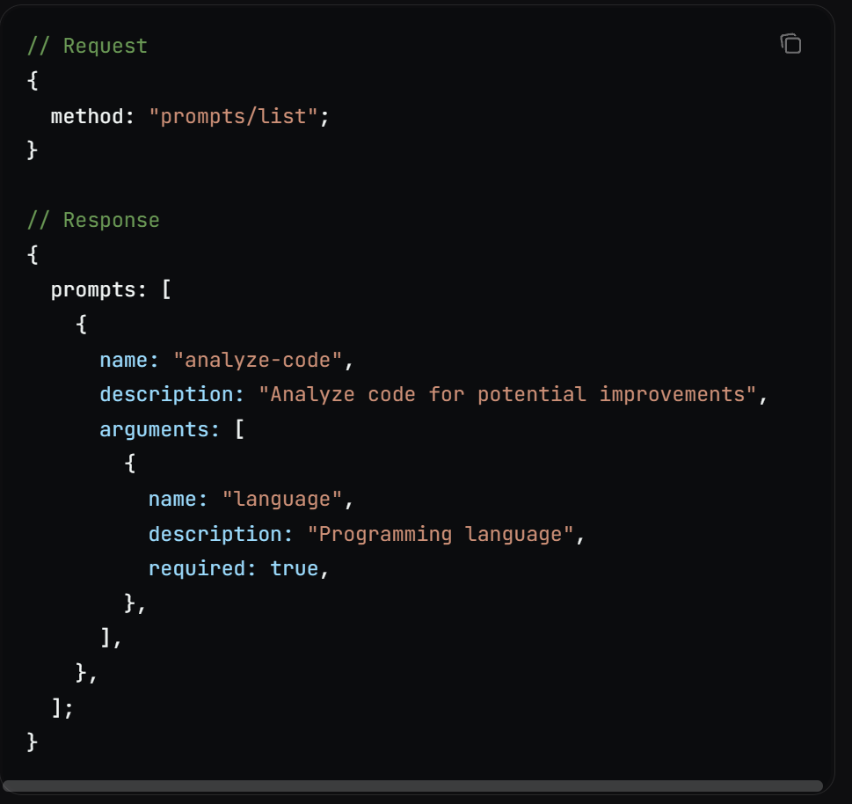
MCP Key Primitive - Prompts
A MCP Prompt has the following Structure
Clients can discover available prompts through the “prompts/list” endpoint

Slide 17
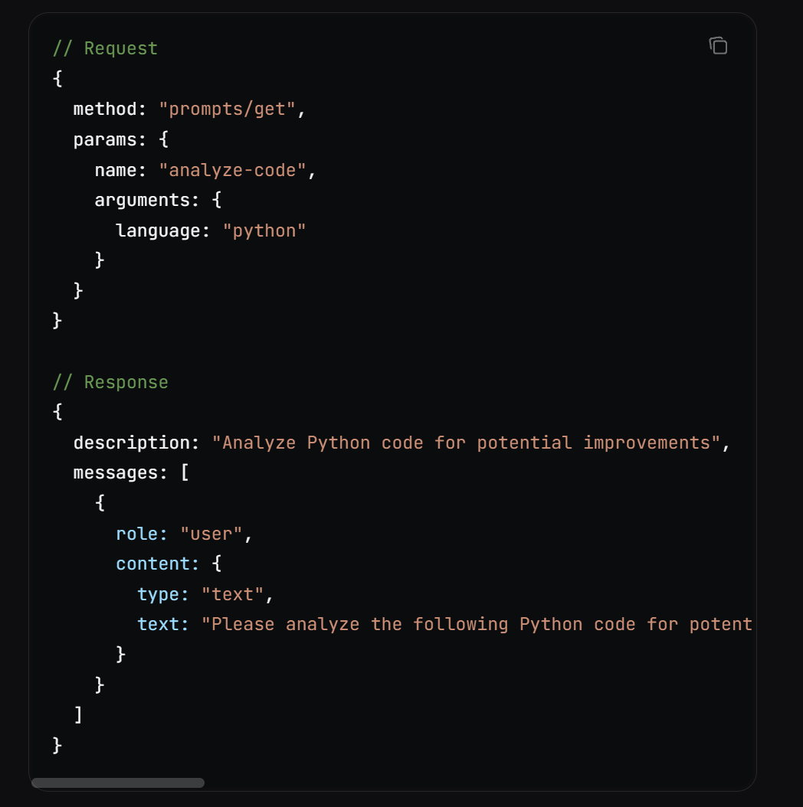
MCP Key Primitive - Prompts
To use a Prompt clients, implement the “prompt/get” request as shown:

Slide 18
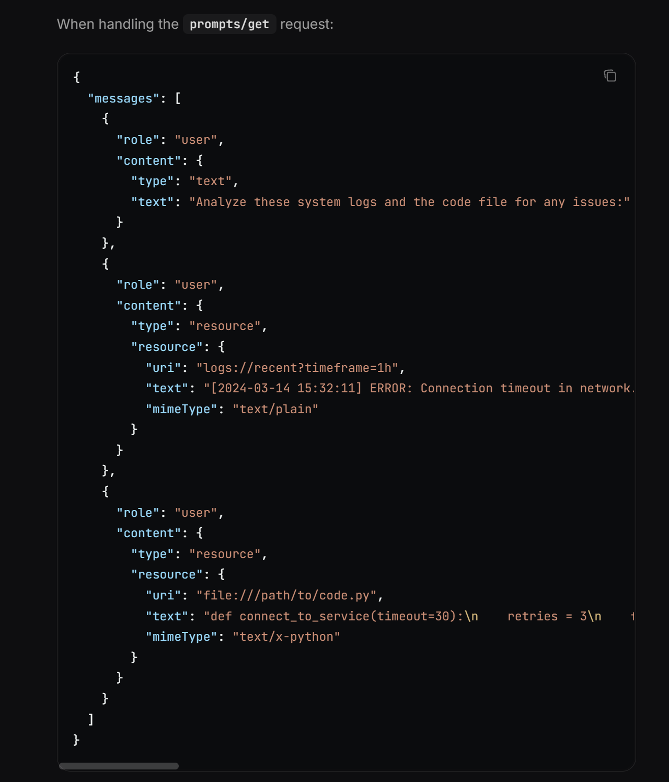
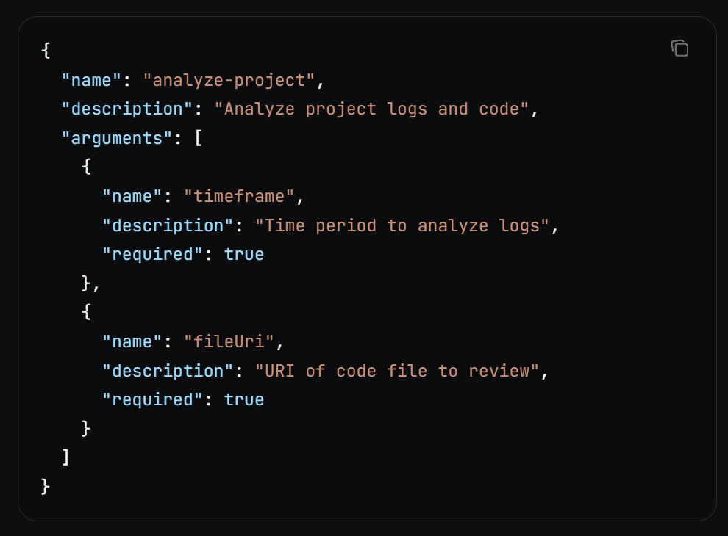
MCP Key Primitive - Prompts
Prompts can be dynamic and include embedded Resource Content (this is important since this is where you slip context (info, real-time stuff, etc). into a prompt response.

Slide 19
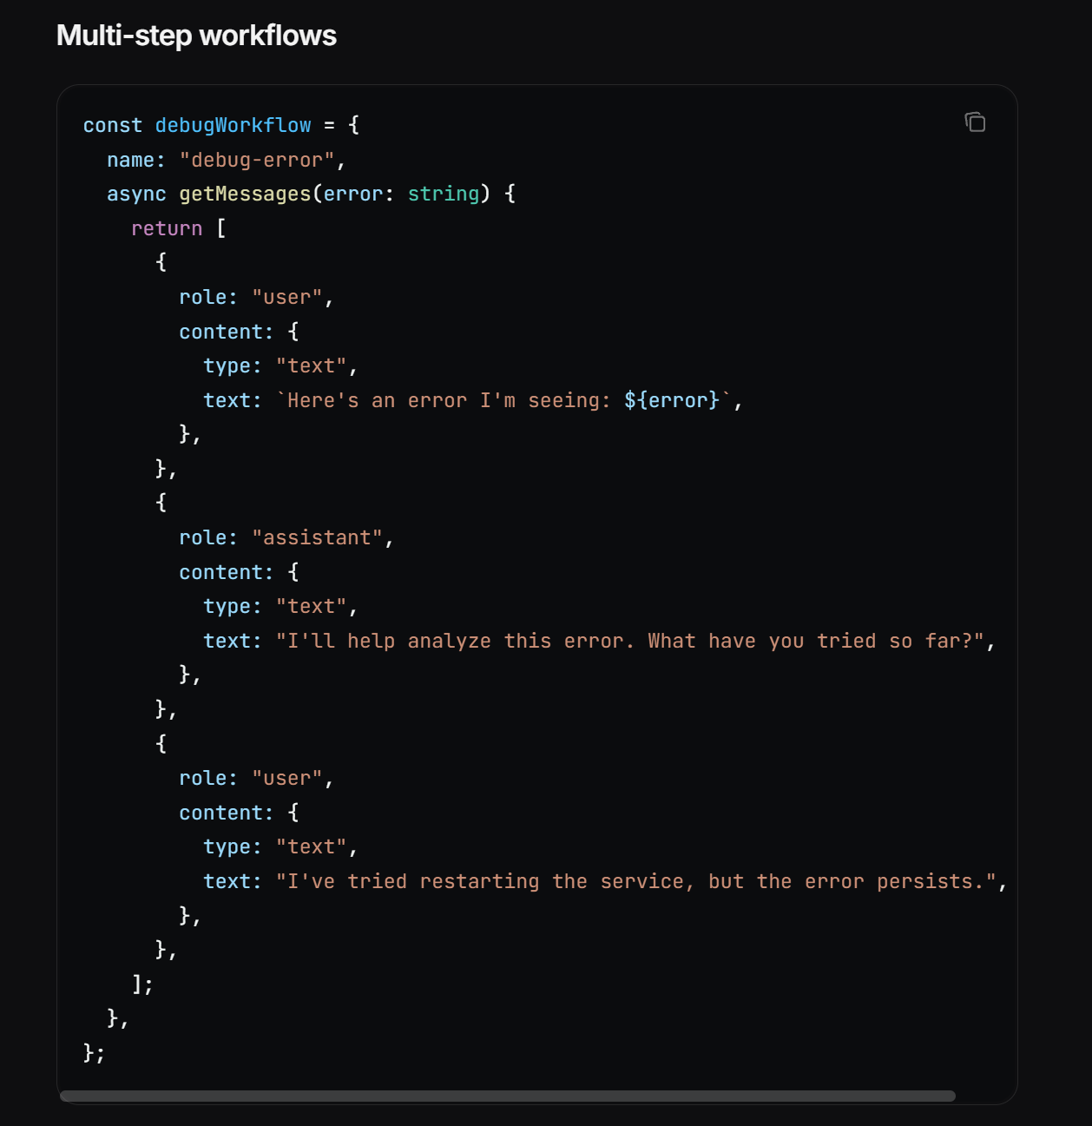
MCP Key Primitive - Prompts
Multi-Step Workflow Example (Dynamic Embedded Content), notice the usages of the “Role/Content” pairs – this is the MCP “Message” in the end (JSONRPC that is underlying)

Slide 20
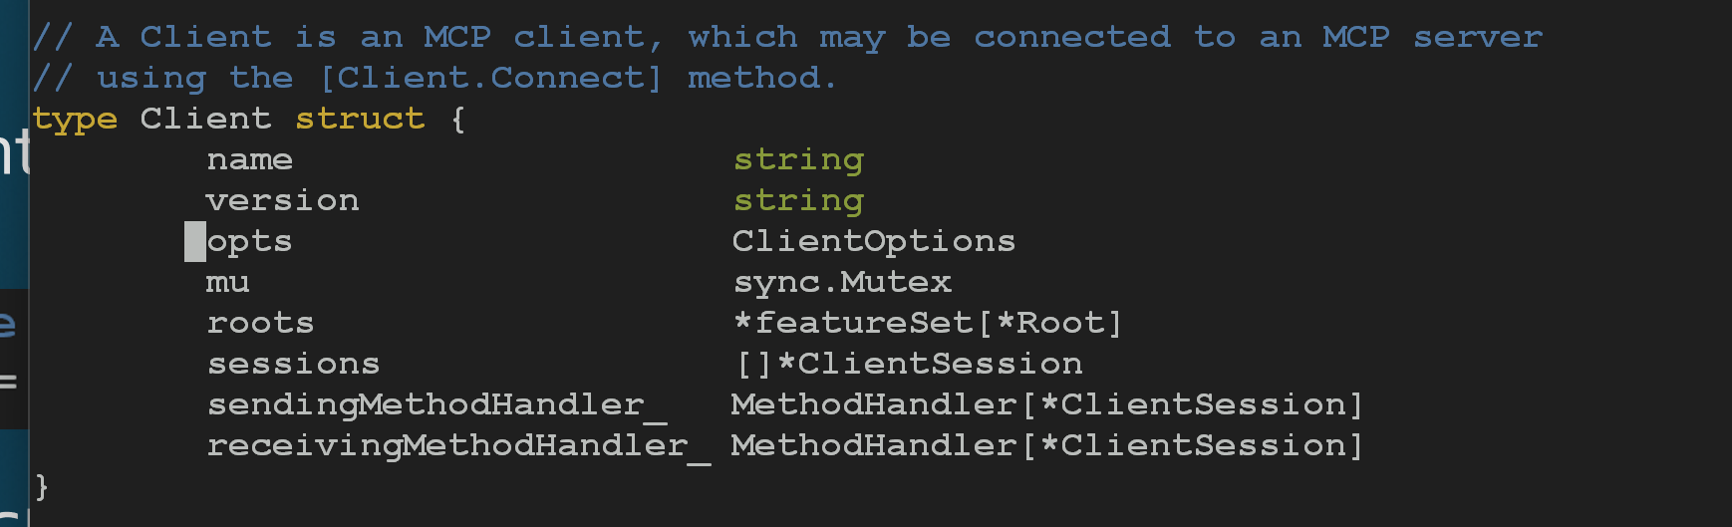
MCP Client - Code Examination
Every Client needs a “client” ☺
The MCP Client Struct (mcplib/client.go)

Slide 21
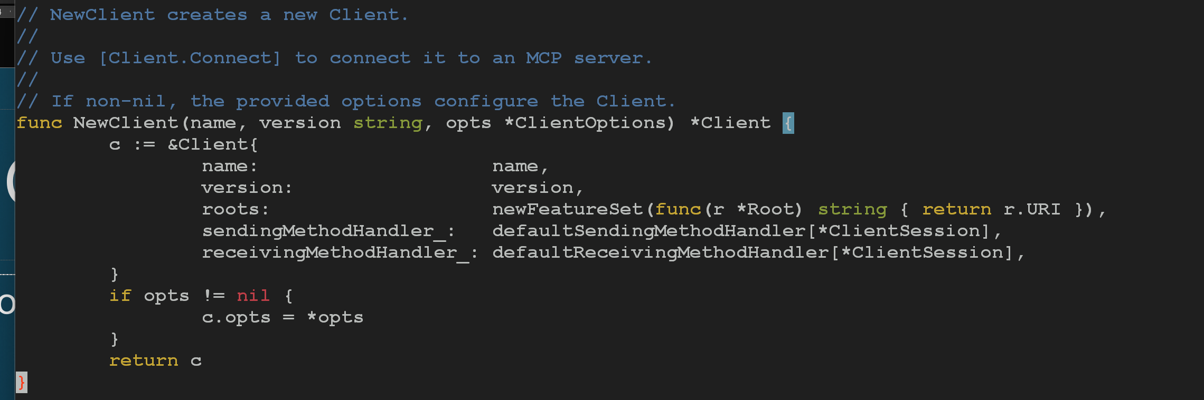
MCP Client – Code Examination
NewClient – Creates a NewClient and provides the .Connect method to connect to our MCP Server (destination)

Slide 22
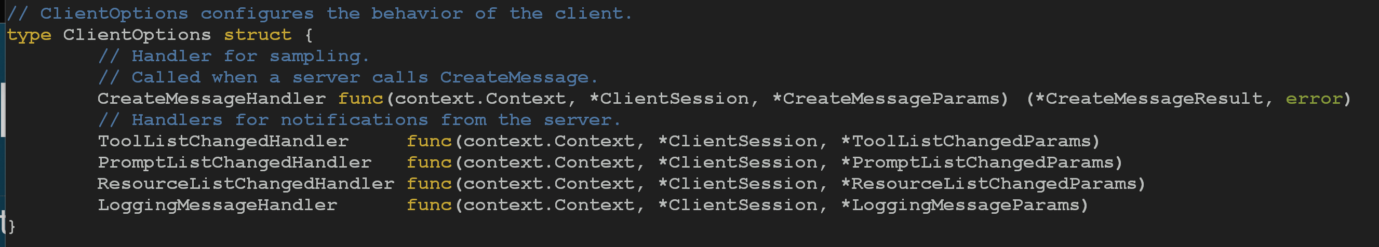
MCP Client – Code Examination
Client Options – The MCP Client implements the following options, which we can see as 5 Essential Handlers
MCP Client
MCP Server
Message Handler(*)
CreateMessage()
ToolList Notif Handler
Notification Handler
PromptList Notif Handler
Resource List Notif Handler
LoggingMessage Notif Handler

Slide 23
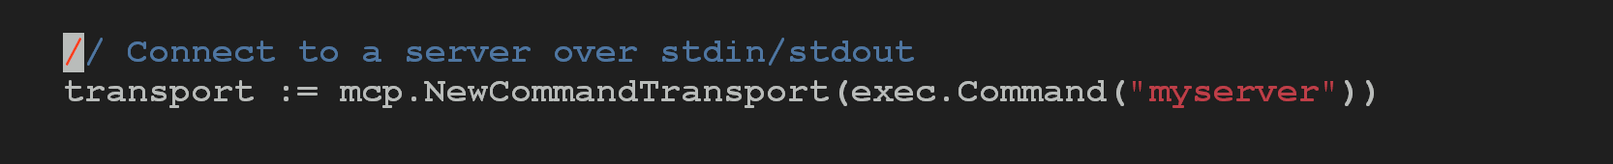
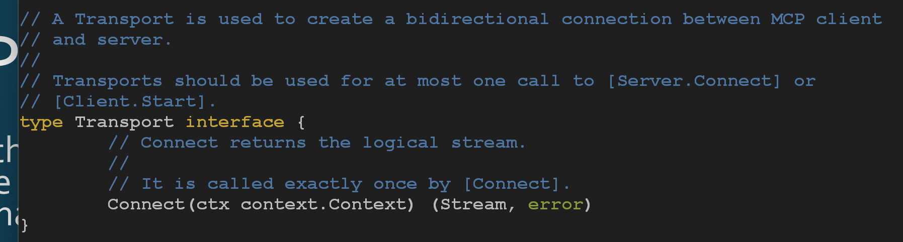
MCP Client – Code Examination
With the Client, we must define a Transport. Presently in the goSDK source Instructions/example show calling the ‘mcp-go-server” via Command line using stdin/stdout.
The Transport Struct is basic, and (as the MCP Protocol states) the Stream is JSONRPC over whatever transport you implement. Looking at the Code options are STDIO, IO, and InMemory Network Link (we will play with this!!)
MCP Transport Struct

Slide 24
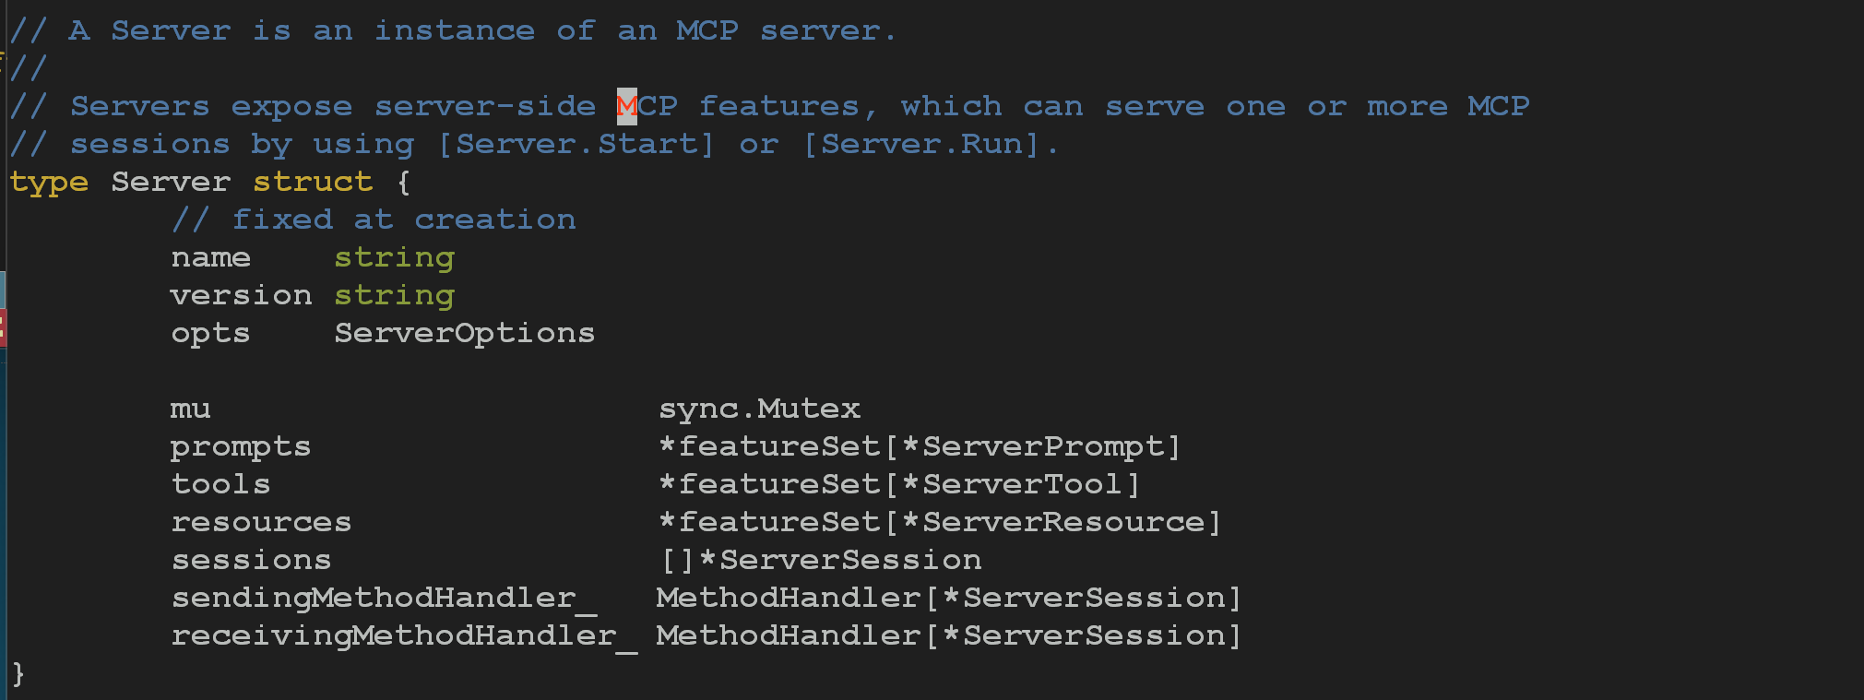
MCP Server – Code Examination
Every Server needs a “server’ ☺
The MCP Server Struct (mcplib/server.go)

Slide 25
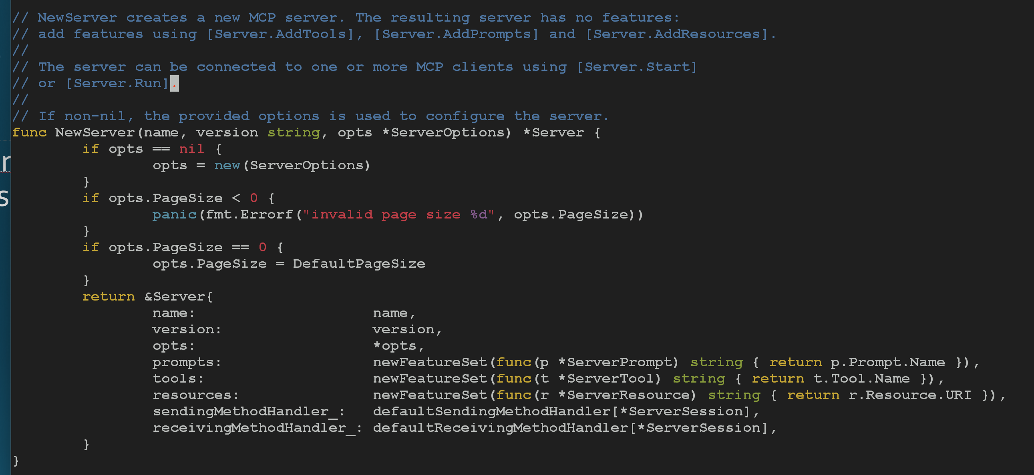
MCP Server – Code Examination
NewServer
Creates a NewServer with Options for Tools, Prompts and Resources (Main three MCP ServerTypes). These can be added to the server instances with the .AddTools, .AddPrompts, .AddResources.
Server.Run or Server.Start to fire up the server.
“FeatureSets” are used for ServerPrompt, ServerTool, and ServerResource Types.
Note: A Prompt and Tool returns a “NAME”, but the Resource returns a URI (important abstraction for MCP

Slide 26
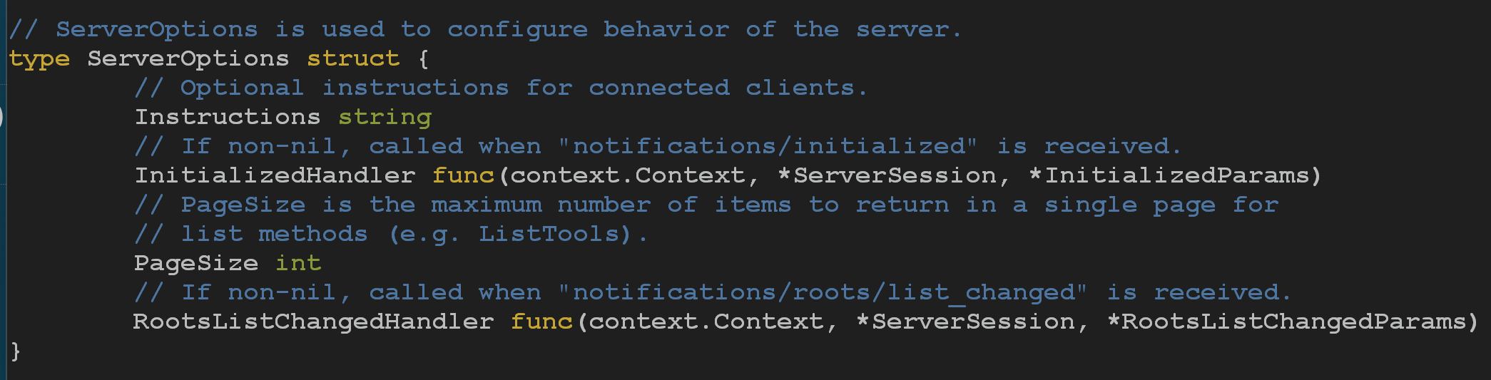
MCP Server – Code Examination
Server Options – The MCP Server Implements the following Options

Slide 27
MCP Explorer
A Framework for exploring and experimenting with Model Context Protocol and learning the MCP Client / MCP Server interactions between themselves, and other entities
MCP Explorer aims to allow MCP Developers to instantiate multiple, unique MCP Clients and instantiate multiple MCP Servers based on configurations and settings all housed within a MCP Host Framework that is built to allow for this sort of deep dive examination.
MCP Explorer examines the MCP Registry options and hooks into many populate MCP Servers to allow test and examination.

Slide 28
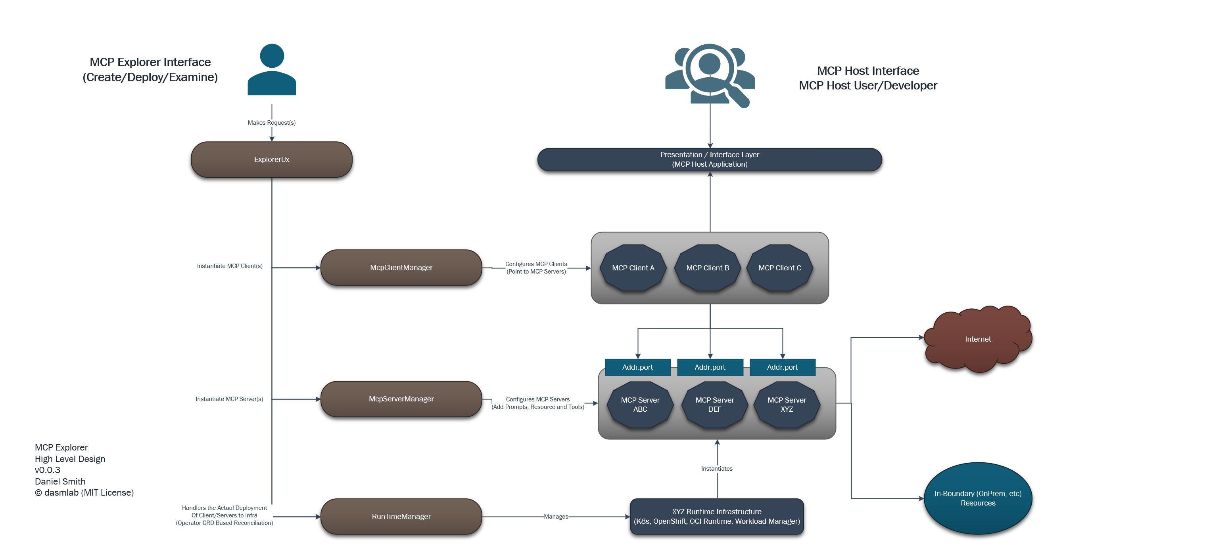
MCP Explorer – High Level Layout
The following is the rough outline of what the MCP Explorer Architecture looks like, so far.

